Slide 1

Week 7– Graphical User Interfaces
Big Java by Cay Horstmann
Copyright © 2009 by John Wiley & Sons. All rights reserved.

Slide 2
Graphical Applications and Frame Windows
To show a frame:
Construct an object of the JFrame class:
JFrame frame = new JFrame();
2. Set the size of the frame:
frame.setSize(300, 400);
If you’d like, set the title of the frame:
frame.setTitle("An Empty Frame");
4. Set the “default close operation”:
frame.setDefaultCloseOperation(JFrame.EXIT_ON_CLOSE);
5. Make the frame visible:
frame.setVisible(true);

Slide 3
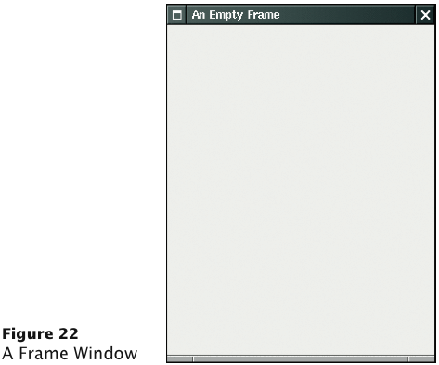
A Frame Window

Slide 4
ch02/emptyframe/EmptyFrameViewer.java
1 import javax.swing.JFrame;
2
3 public class EmptyFrameViewer
4 {
5 public static void main(String[] args)
6 {
7 JFrame frame = new JFrame();
8
9 frame.setSize(300, 400);
10 frame.setTitle("An Empty Frame");
11 frame.setDefaultCloseOperation(JFrame.EXIT_ON_CLOSE);
12
13 frame.setVisible(true);
14 }
15 }

Slide 5
Drawing on a Component
In order to display a drawing in a frame, define a class that extends the JComponent class
Place drawing instructions inside the paintComponent method. That method is called whenever the component needs to be repainted:
public class RectangleComponent extends JComponent
{
public void paintComponent(Graphics g)
{
Drawing instructions go here
}
}

Slide 6
Classes Graphics and Graphics2D
Graphics class lets you manipulate the graphics state (such as current color)
Graphics2D class has methods to draw shape objects
Use a cast to recover the Graphics2D object from the Graphics parameter:
public class RectangleComponent extends JComponent
{
public void paintComponent(Graphics g)
{
// Recover Graphics2D
Graphics2D g2 = (Graphics2D) g;
. . .
}
}

Slide 7
Classes Graphics and Graphics2D
Call method draw of the Graphics2D class to draw shapes, such as rectangles, ellipses, line segments, polygons, and arcs:
public class RectangleComponent extends JComponent
{
public void paintComponent(Graphics g)
{
. . .
Rectangle box = new Rectangle(5, 10, 20, 30);
g2.draw(box);
. . .
}
}

Slide 8
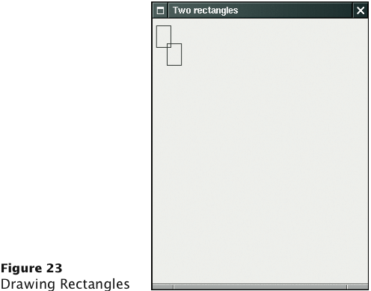
Drawing Rectangles

Slide 9
ch02/rectangles/RectangleComponent.java
1 import java.awt.Graphics;
2 import java.awt.Graphics2D;
3 import java.awt.Rectangle;
4 import javax.swing.JComponent;
5
6 /**
7 A component that draws two rectangles.
8 */
9 public class RectangleComponent extends JComponent
10 {
11 public void paintComponent(Graphics g)
12 {
13 // Recover Graphics2D
14 Graphics2D g2 = (Graphics2D) g;
15
16 // Construct a rectangle and draw it
17 Rectangle box = new Rectangle(5, 10, 20, 30);
18 g2.draw(box);
19
Continued

Slide 10
ch02/rectangles/RectangleComponent.java (cont.)
20 // Move rectangle 15 units to the right and 25 units down
21 box.translate(15, 25);
22
23 // Draw moved rectangle
24 g2.draw(box);
25 }
26 }

Slide 11
ch02/rectangles/RectangleViewer.java
1 import javax.swing.JFrame;
2
3 public class RectangleViewer
4 {
5 public static void main(String[] args)
6 {
7 JFrame frame = new JFrame();
8
9 frame.setSize(300, 400);
10 frame.setTitle("Two rectangles");
11 frame.setDefaultCloseOperation(JFrame.EXIT_ON_CLOSE);
12
13 RectangleComponent component = new RectangleComponent();
14 frame.add(component);
15
16 frame.setVisible(true);
17 }
18 }

Slide 12
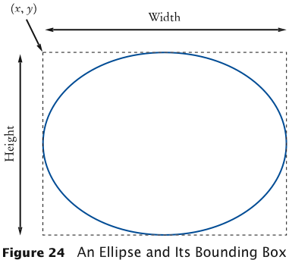
Ellipses
Ellipse2D.Double describes an ellipse
This class is an inner class – doesn’t matter to us except for the import statement:
import java.awt.geom.Ellipse2D; // no .Double
Must construct and draw the shape:
Ellipse2D.Double ellipse =
new Ellipse2D.Double(x, y, width, height);
g2.draw(ellipse);

Slide 13
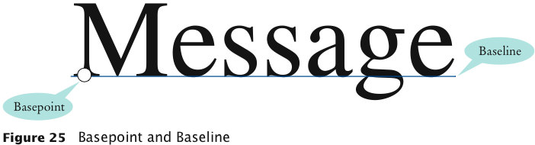
Drawing Lines
To draw a line:
Line2D.Double segment =
new Line2D.Double(x1, y1, x2, y2);
g2.draw(segment);
or, Point2D.Double from = new Point2D.Double(x1, y1);
Point2D.Double to = new Point2D.Double(x2, y2);
Line2D.Double segment = new Line2D.Double(from, to);
g2.draw(segment);
Drawing Text
g2.drawString("Message", 50, 100);

Slide 14
Colors
Color | RGB Value
Color.BLACK | 0, 0, 0
Color.BLUE | 0, 0, 255
Color.CYAN | 0, 255, 255
Color.GRAY | 128, 128, 128
Color.DARKGRAY | 64, 64, 64
Color.LIGHTGRAY | 192, 192, 192
Color.GREEN | 0, 255, 0
Color.MAGENTA | 255, 0, 255
Color.ORANGE | 255, 200, 0
Color.PINK | 255, 175, 175
Color.RED | 255, 0, 0
Color.WHITE | 255, 255, 255
Color.YELLOW | 255, 255, 0
Standard colors Color.BLUE, Color.RED, Color.PINK.
Specify red, green, blue between 0 and 255:
Color magenta = new Color(255, 0, 255);
Set color in graphics context:
g2.setColor(magenta);
Color is used when drawing and filling shapes:
g2.fill(rectangle);

Slide 15
Drawing Cars
Draw two cars: one in top-left corner of window, and another in the bottom right
Compute bottom right position, inside paintComponent method:
int x = getWidth() - 60; int y = getHeight() - 30;
Car car2 = new Car(x, y);
getWidth and getHeight are applied to object that executes paintComponent
If window is resized paintComponent is called and car position recomputed
Continued

Slide 16
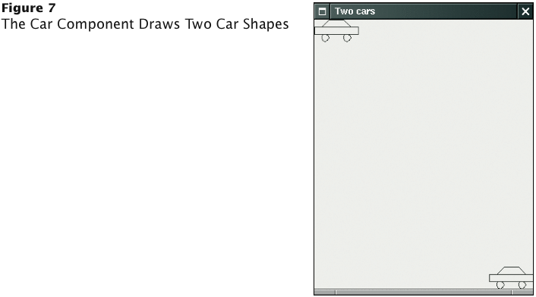
Classes of Car Drawing Program
Car: responsible for drawing a single car
Two objects of this class are constructed, one for each car
CarComponent: displays the drawing
CarViewer: shows a frame that contains a CarComponent

Slide 17
ch03/car/Car.java
1 import java.awt.Graphics2D;
2 import java.awt.Rectangle;
3 import java.awt.geom.Ellipse2D;
4 import java.awt.geom.Line2D;
5 import java.awt.geom.Point2D;
6
7 /**
8 A car shape that can be positioned anywhere on the screen.
9 */
10 public class Car
11 {
12 private int xLeft;
13 private int yTop;
14
15 /**
16 Constructs a car with a given top left corner.
17 @param x the x coordinate of the top left corner
18 @param y the y coordinate of the top left corner
19 */
20 public Car(int x, int y)
21 {
22 xLeft = x;
23 yTop = y;
24 }
Continued

Slide 18
ch03/car/Car.java (cont.)
25
26 /**
27 Draws the car.
28 @param g2 the graphics context
29 */
30 public void draw(Graphics2D g2)
31 {
32 Rectangle body
33 = new Rectangle(xLeft, yTop + 10, 60, 10);
34 Ellipse2D.Double frontTire
35 = new Ellipse2D.Double(xLeft + 10, yTop + 20, 10, 10);
36 Ellipse2D.Double rearTire
37 = new Ellipse2D.Double(xLeft + 40, yTop + 20, 10, 10);
38
39 // The bottom of the front windshield
40 Point2D.Double r1
41 = new Point2D.Double(xLeft + 10, yTop + 10);
42 // The front of the roof
43 Point2D.Double r2
44 = new Point2D.Double(xLeft + 20, yTop);
45 // The rear of the roof
46 Point2D.Double r3
47 = new Point2D.Double(xLeft + 40, yTop);
Continued

Slide 19
ch03/car/Car.java (cont.)
48 // The bottom of the rear windshield
49 Point2D.Double r4
50 = new Point2D.Double(xLeft + 50, yTop + 10);
51
52 Line2D.Double frontWindshield
53 = new Line2D.Double(r1, r2);
54 Line2D.Double roofTop
55 = new Line2D.Double(r2, r3);
56 Line2D.Double rearWindshield
57 = new Line2D.Double(r3, r4);
58
59 g2.draw(body);
60 g2.draw(frontTire);
61 g2.draw(rearTire);
62 g2.draw(frontWindshield);
63 g2.draw(roofTop);
64 g2.draw(rearWindshield);
65 }
66 }

Slide 20
ch03/car/CarComponent.java
1 import java.awt.Graphics;
2 import java.awt.Graphics2D;
3 import javax.swing.JComponent;
4
5 /**
6 This component draws two car shapes.
7 */
8 public class CarComponent extends JComponent
9 {
10 public void paintComponent(Graphics g)
11 {
12 Graphics2D g2 = (Graphics2D) g;
13
14 Car car1 = new Car(0, 0);
15
16 int x = getWidth() - 60;
17 int y = getHeight() - 30;
18
19 Car car2 = new Car(x, y);
20
21 car1.draw(g2);
22 car2.draw(g2);
23 }
24 }

Slide 21
ch03/car/CarViewer.java
1 import javax.swing.JFrame;
2
3 public class CarViewer
4 {
5 public static void main(String[] args)
6 {
7 JFrame frame = new JFrame();
8
9 frame.setSize(300, 400);
10 frame.setTitle("Two cars");
11 frame.setDefaultCloseOperation(JFrame.EXIT_ON_CLOSE);
12
13 CarComponent component = new CarComponent();
14 frame.add(component);
15
16 frame.setVisible(true);
17 }
18 }

Slide 22
Processing Text Input
The actionPerformed method of the button's ActionListener reads the user input from the text fields (use getText):
class AddInterestListener implements ActionListener
{
public void actionPerformed(ActionEvent event)
{
double rate =
Double.parseDouble(rateField.getText());
double interest = account.getBalance() * rate / 100;
account.deposit(interest);
resultLabel.setText("balance: ”
+ account.getBalance());
}
}

Slide 23
Text Areas
Use a JTextArea to show multiple lines of text
You can specify the number of rows and columns:
final int ROWS = 10;
final int COLUMNS = 30;
JTextArea textArea = new JTextArea(ROWS, COLUMNS);
setText: to set the text of a text field or text area
append: to add text to the end of a text area
Use newline characters to separate lines: textArea.append(account.getBalance() + "\n");
To use for display purposes only:
textArea.setEditable(false);
// program can call setText and append to change it

Slide 24
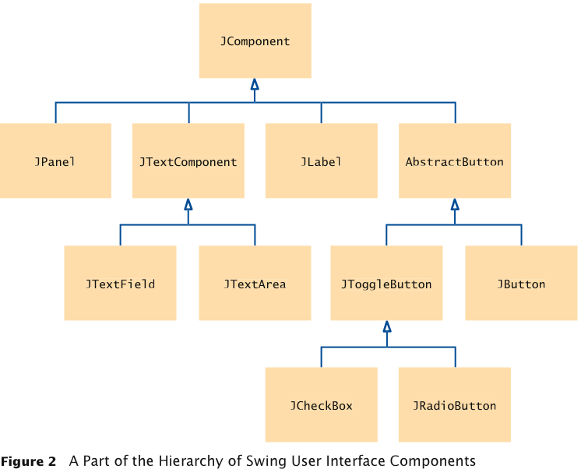
Text Areas
Classes JTextField and JTextArea are subclasses of library class JTextComponent
Methods setText and setEditable are declared in the JTextComponent class and inherited by JTextField and JTextArea
Method append is declared in the JTextArea class

Slide 25
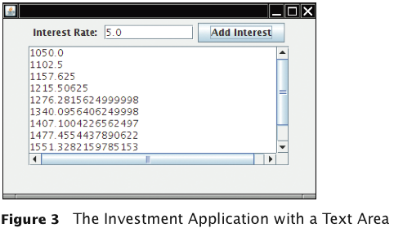
Text Areas
To add scroll bars to a text area:
JTextArea textArea = new JTextArea(ROWS, COLUMNS); JScrollPane scrollPane = new JScrollPane(textArea);

Slide 26
Layout Management
Up to now, we have had limited control over layout of components
When we used a panel, it arranged the components from the left to the right
User-interface components are arranged by placing them inside containers
Containers can be placed inside larger containers
Each container has a layout manager that directs the arrangement of its components
Three useful layout managers:
border layout
flow layout
grid layout

Slide 27
Layout Management
By default, JPanel places components from left to right and starts a new row when needed
Panel layout carried out by FlowLayout layout manager
Can set other layout managers:
panel.setLayout(new BorderLayout());

Slide 28
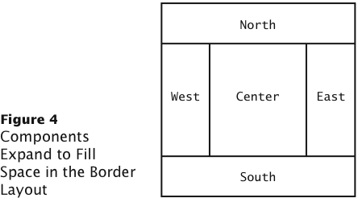
Border Layout
Border layout groups container into five areas - center, north, west, south and east

Slide 29
Border Layout
Default layout manager for a frame (technically, the frame’s content pane)
When adding a component, specify the position like this:
panel.add(component, BorderLayout.NORTH);
Expands each component to fill the entire allotted area If that is not desirable, place each component inside a panel

Slide 30
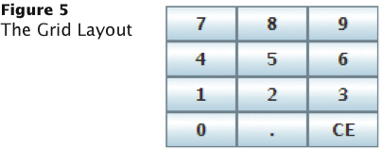
Grid Layout
Arranges components in a grid with a fixed number of rows and columns
Resizes each component so that they all have same size
Expands each component to fill the entire allotted area
Add the components, row by row, left to right:
JPanel numberPanel = new JPanel(); numberPanel.setLayout(new GridLayout(4, 3)); numberPanel.add(button7); numberPanel.add(button8); numberPanel.add(button9); numberPanel.add(button4); ...

Slide 31
Grid Bag Layout
Tabular arrangement of components
Columns can have different sizes
Components can span multiple columns
Quite complex to use
Not covered in the book
Fortunately, you can create acceptable-looking layouts by nesting panels
Give each panel an appropriate layout manager
Panels don’t have visible borders
Use as many panels as needed to organize components

Slide 32
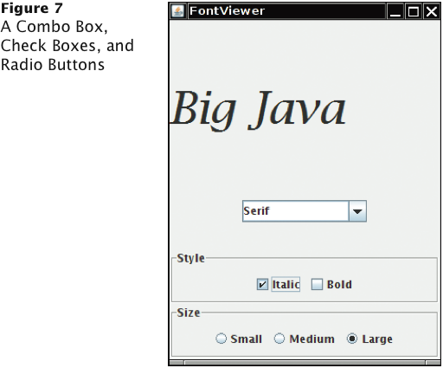
Radio Buttons
For a small set of mutually exclusive choices, use radio buttons or a combo box
In a radio button set, only one button can be selected at a time
When a button is selected, previously selected button in set is automatically turned off

Slide 33
Radio Buttons
In previous figure, font sizes are mutually exclusive:
JRadioButton smallButton = new JRadioButton("Small"); JRadioButton mediumButton = new JRadioButton("Medium"); JRadioButton largeButton = new JRadioButton("Large"); // Add radio buttons into a ButtonGroup so that // only one button in group is on at any time ButtonGroup group = new ButtonGroup(); group.add(smallButton); group.add(mediumButton); group.add(largeButton);

Slide 34
Radio Buttons
Button group does not place buttons close to each other on container
It is your job to arrange buttons on screen
isSelected: Called to find out if a button is currently selected or not:
if(largeButton.isSelected()) size = LARGE_SIZE
Call setSelected(true) on a radio button in group before making the enclosing frame visible

Slide 35
Borders
Place a border around a panel to group its contents visually
EtchedBorder: Three-dimensional etched effect
Can add a border to any component, but most commonly to panels:
JPanel panel = new JPanel(); panel.setBorder(new EtchedBorder());
TitledBorder: A border with a title:
panel.setBorder(new TitledBorder(new EtchedBorder(),
"Size"));

Slide 36
Check Boxes
Two states: Checked and unchecked
Use one checkbox for a binary choice
Use a group of check boxes when one selection does not exclude another
Example: “Bold” and “Italic” in previous figure
Construct by giving the name in the constructor:
JCheckBox italicCheckBox = new JCheckBox("Italic");
Don’t place into a button group

Slide 37
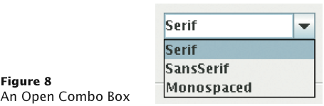
Combo Boxes
For a large set of choices, use a combo box
Uses less space than radio buttons
“Combo”: Combination of a list and a text field
The text field displays the name of the current selection

Slide 38
Combo Boxes
If combo box is editable, user can type own selection
Use setEditable method
Add strings with addItem method:
JComboBox facenameCombo = new JComboBox(); facenameCombo.addItem("Serif"); facenameCombo.addItem("SansSerif"); ...
Get user selection with getSelectedItem (return type is Object):
String selectedString =
(String) facenameCombo.getSelectedItem();
Select an item with setSelectedItem

Slide 39
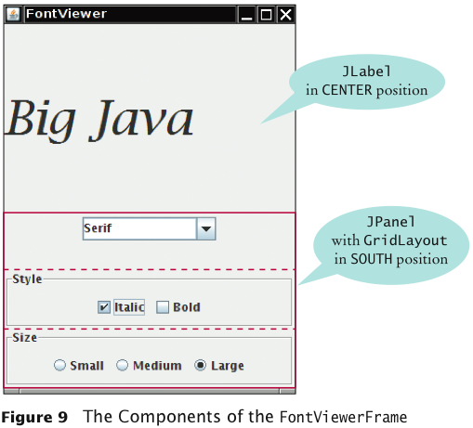
Radio Buttons, Check Boxes, and Combo Boxes
They generate an ActionEvent whenever the user selects an item
An example: FontViewerFrame

Slide 40
Radio Buttons, Check Boxes, and Combo Boxes
All components notify the same listener object
When user clicks on any component, we ask each component for its current content
Then redraw text sample with the new font

Slide 41
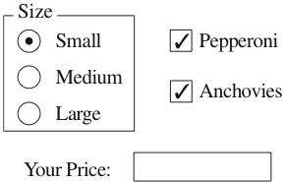
How To 18.1 Laying Out a User Interface
Step 1: Make a sketch of your desired component layout

Slide 42
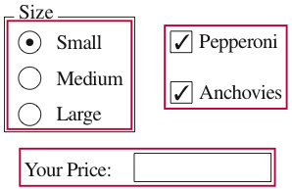
How To 18.1 Laying Out a User Interface (cont.)
Step 2: Find groupings of adjacent components with the same layout

Slide 43
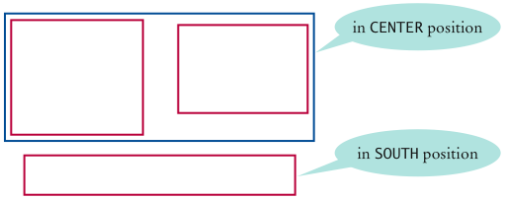
How To 18.1 Laying Out a User Interface (cont.)
Step 3: Identify layouts for each group
Step 4: Group the groups together
Step 5: Write the code to generate the layout

Slide 44
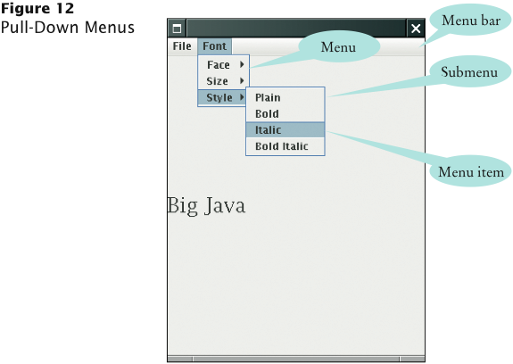
Menus
A frame contains a menu bar
The menu bar contains menus
A menu contains submenus and menu items

Slide 45
Menu Items
Add menu items and submenus with the add method:
JMenuItem fileExitItem = new JMenuItem("Exit"); fileMenu.add(fileExitItem);
A menu item has no further submenus
Menu items generate action events
Add a listener to each menu item:
fileExitItem.addActionListener(listener);
Add action listeners only to menu items, not to menus or the menu bar

Slide 46
Exploring the Swing Documentation
For more sophisticated effects, explore the Swing documentation
The documentation can be quite intimidating at first glance
Next example will show how to use the documentation to your advantage

Slide 47
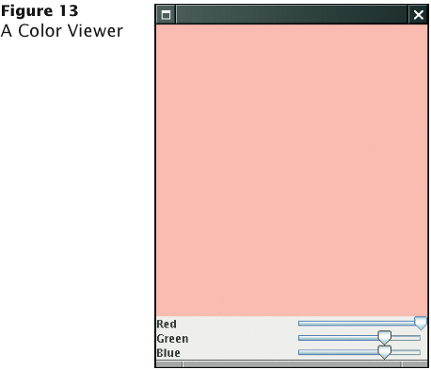
Example: A Color Viewer
It should be fun to mix your own colors, with a slider for the red, green, and blue values

Slide 48
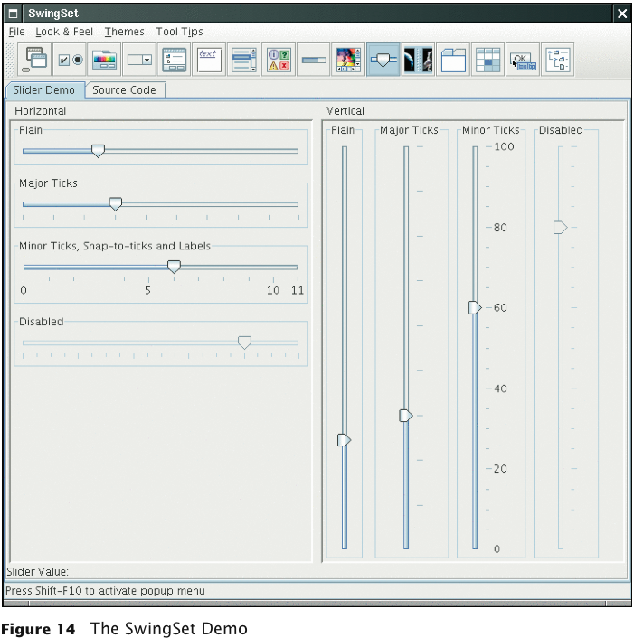
The SwingSet Demo

Slide 49
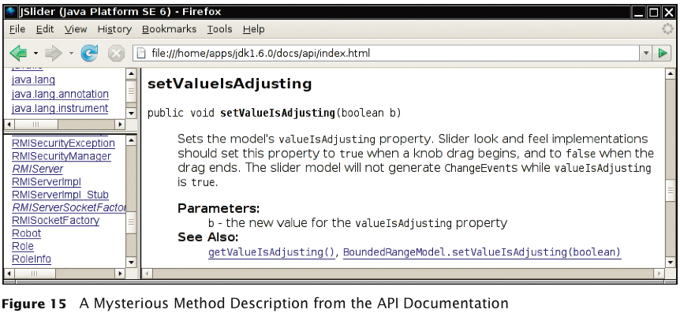
Example: A Color Viewer
There are over 50 methods in JSlider class and over 250 inherited methods
Some method descriptions look scary:
Develop the ability to separate fundamental concepts from ephemeral minutiae

Slide 50
How do I construct a JSlider?
Look at the Java version 6 API documentation
There are six constructors for the JSlider class
Learn about one or two of them
Strike a balance somewhere between the trivial and the bizarre
Too limited:
public JSlider()
Creates a horizontal slider with the range 0 to 100 and an initial value of 50

Slide 51
How Do I Construct a Jslider?
Bizarre:
public JSlider(BoundedRangeModel brm)
Creates a horizontal slider using the specified BoundedRangeModel
Useful:
public JSlider(int min, int max, int value)
Creates a horizontal slider using the specified min, max, and value

Slide 52
How Can I Get Notified When the User Has Moved a JSlider?
There is no addActionListener method
There is a method:
public void addChangeListener(ChangeListener l)
Click on the ChangeListener link to learn more
It has a single method:
void stateChanged(ChangeEvent e)
Apparently, method is called whenever user moves the slider
What is a ChangeEvent?
It inherits getSource method from superclass EventObject
getSource: Tells us which component generated this event

Slide 53
How Can I Tell To Which Value the User Has Set a JSlider?
Now we have a plan:
Add a change event listener to each slider
When slider is changed, stateChanged method is called
Find out the new value of the slider
Recompute color value
Repaint color panel
Need to get the current value of the slider
Look at all the methods that start with get; you find:
public int getValue()
Returns the slider’s value

Slide 54
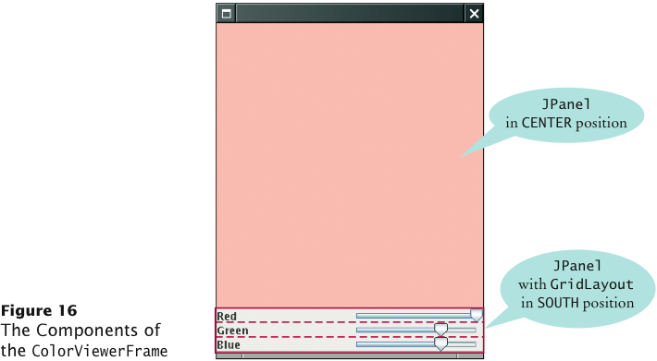
The Components of the ColorViewerFrame

Slide 55
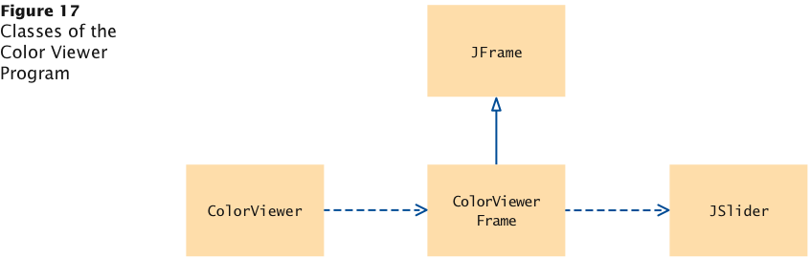
Classes of the Color Viewer Program

Slide 56
ch18/slider/ColorViewer.java
1 import javax.swing.JFrame;
2
3 public class ColorViewer
4 {
5 public static void main(String[] args)
6 {
7 ColorViewerFrame frame = new ColorViewerFrame();
8 frame.setDefaultCloseOperation(JFrame.EXIT_ON_CLOSE);
9 frame.setVisible(true);
10 }
11 }
12

Slide 57
ch18/slider/ColorViewerFrame.java
1 import java.awt.BorderLayout;
2 import java.awt.Color;
3 import java.awt.GridLayout;
4 import javax.swing.JFrame;
5 import javax.swing.JLabel;
6 import javax.swing.JPanel;
7 import javax.swing.JSlider;
8 import javax.swing.event.ChangeListener;
9 import javax.swing.event.ChangeEvent;
10
11 public class ColorViewerFrame extends JFrame
12 {
13 private static final int FRAME_WIDTH = 300;
14 private static final int FRAME_HEIGHT = 400;
15
16 private JPanel colorPanel;
17 private JSlider redSlider;
18 private JSlider greenSlider;
19 private JSlider blueSlider;
20

Slide 58
ch18/slider/ColorViewerFrame.java (cont.)
21 public ColorViewerFrame()
22 {
23 colorPanel = new JPanel();
24
25 add(colorPanel, BorderLayout.CENTER);
26 createControlPanel();
27 setSampleColor();
28 setSize(FRAME_WIDTH, FRAME_HEIGHT);
29 }
30
31 public void createControlPanel()
32 {
33 class ColorListener implements ChangeListener
34 {
35 public void stateChanged(ChangeEvent event)
36 {
37 setSampleColor();
38 }
39 }
40
41 ChangeListener listener = new ColorListener();
42

Slide 59
ch18/slider/ColorViewerFrame.java (cont.)
43 redSlider = new JSlider(0, 255, 255);
44 redSlider.addChangeListener(listener);
45
46 greenSlider = new JSlider(0, 255, 175);
47 greenSlider.addChangeListener(listener);
48
49 blueSlider = new JSlider(0, 255, 175);
50 blueSlider.addChangeListener(listener);
51
52 JPanel controlPanel = new JPanel();
53 controlPanel.setLayout(new GridLayout(3, 2));
54
55 controlPanel.add(new JLabel("Red"));
56 controlPanel.add(redSlider);
57
58 controlPanel.add(new JLabel("Green"));
59 controlPanel.add(greenSlider);
60
61 controlPanel.add(new JLabel("Blue"));
62 controlPanel.add(blueSlider);
63
64 add(controlPanel, BorderLayout.SOUTH);
65 }
66

Slide 60
ch18/slider/ColorViewerFrame.java (cont.)
67 /**
68 Reads the slider values and sets the panel to
69 the selected color.
70 */
71 public void setSampleColor()
72 {
73 // Read slider values
74
75 int red = redSlider.getValue();
76 int green = greenSlider.getValue();
77 int blue = blueSlider.getValue();
78
79 // Set panel background to selected color
80
81 colorPanel.setBackground(new Color(red, green, blue));
82 colorPanel.repaint();
83 }
84 }

